Slide 1
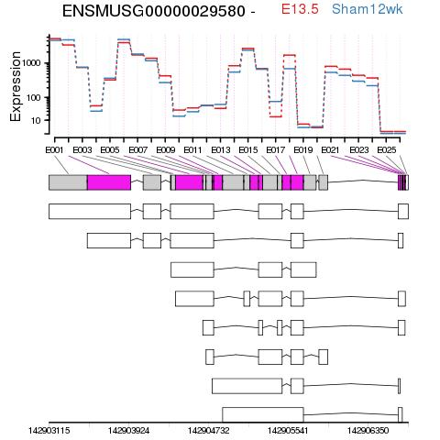
ACTB
Aggregated
ENSMUST00000100497
ENSMUST00000167721
ENSMUST00000171419
ENSMUST00000167386
ENSMUST00000163829
ENSMUST00000106216
ENSMUST00000165629
ENSMUST00000164765

Slide 2
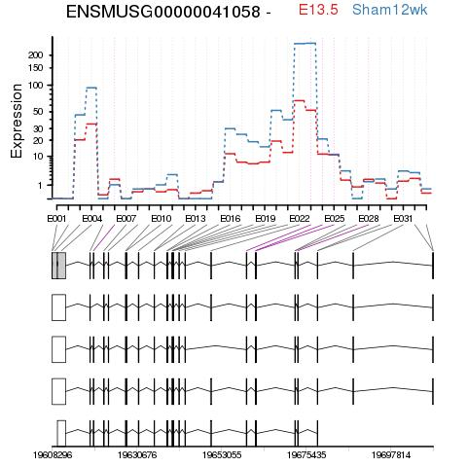
WWP1
Aggregated
ENSMUST00000108246
ENSMUSTTV074090 (NR_074089.1)
ENSMUSTTV074089 (NR_074090.1)
ENSMUST00000035982

Slide 3
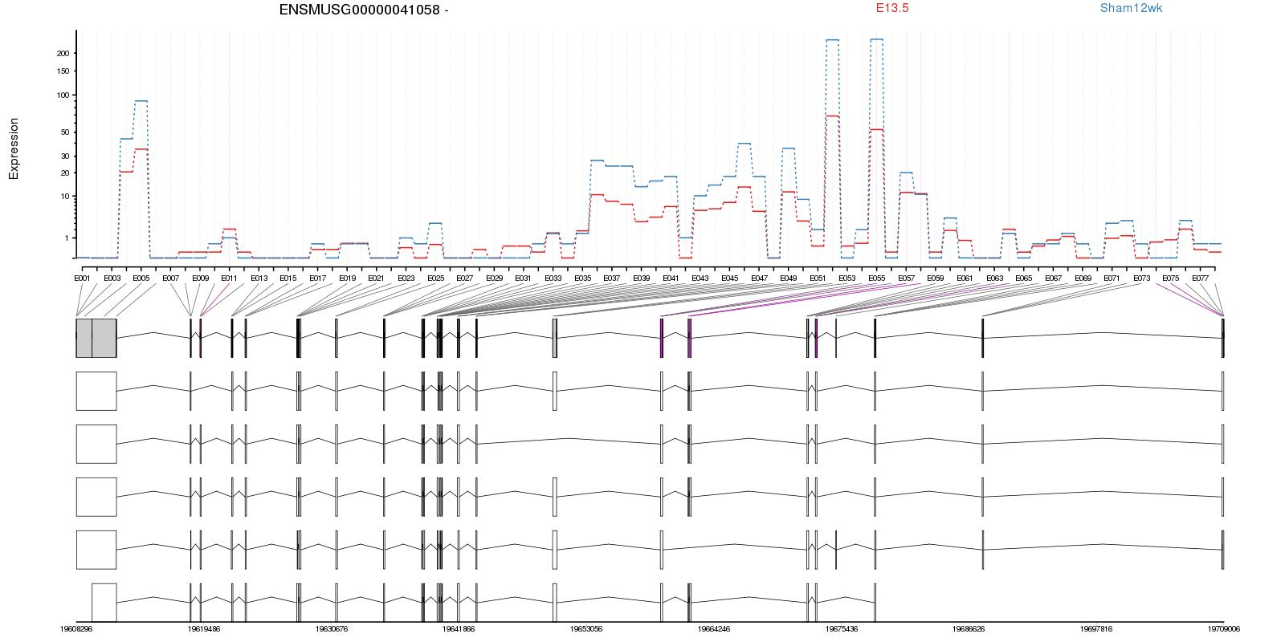
Embryo V Sham WWP1
Aggregated
ENSMUST00000108246
ENSMUSTTV074090 (NR_074089.1)
ENSMUSTTV074089 (NR_074090.1)
NM_001276292.1
ENSMUST00000035982

